Slide 1

IOT in warehouse
Evolving for future

Slide 2
This blog explores ways how IoT solutions for warehouse management can transform warehouse operations such as picking, packing, receiving, dock scheduling and monitoring.IoT in warehouse management includes various types of automation, like tracking and monitoring processes, optimizing storage and retrieval systems, improving productivity and safety. Storage, movement, and fulfillment of goods through warehouses and distribution centers, however, still suffer from damages, spoilage, and incomplete shipments.

Slide 3
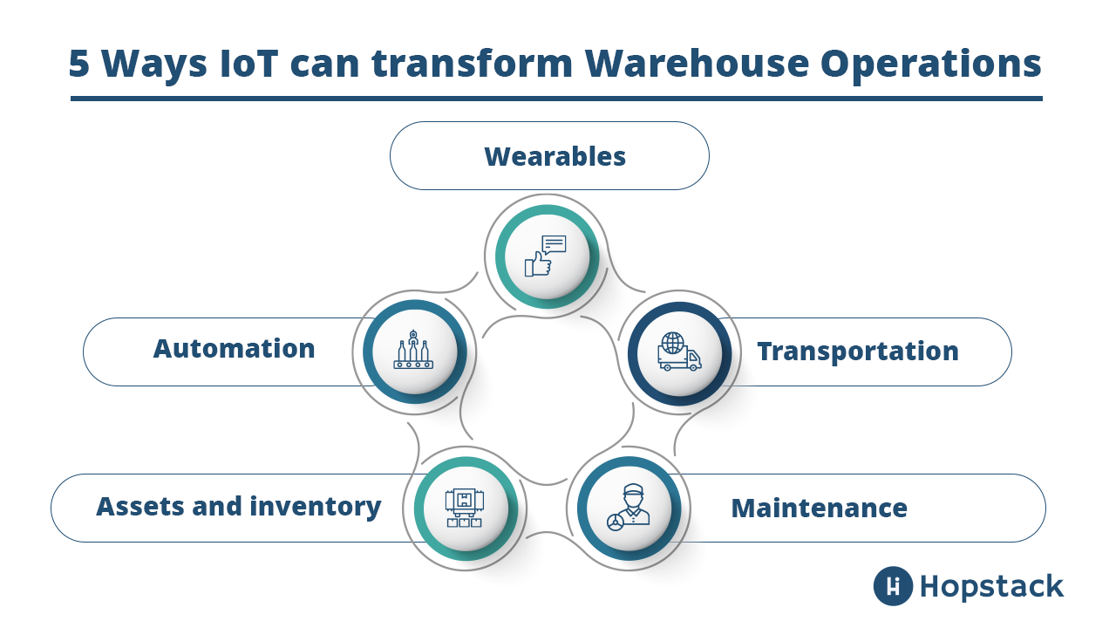

Slide 4
AUTOMATION
IoT devices such as robotic units do more than just assemble orders. These devices collect tons of data, including information on stocks and inventory, the efficiency of the warehouse, and so on, allowing employees to focus on more customer-facing tasks.

Slide 5
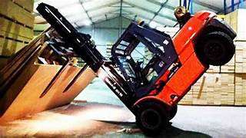


Slide 6
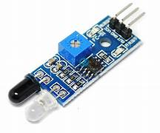
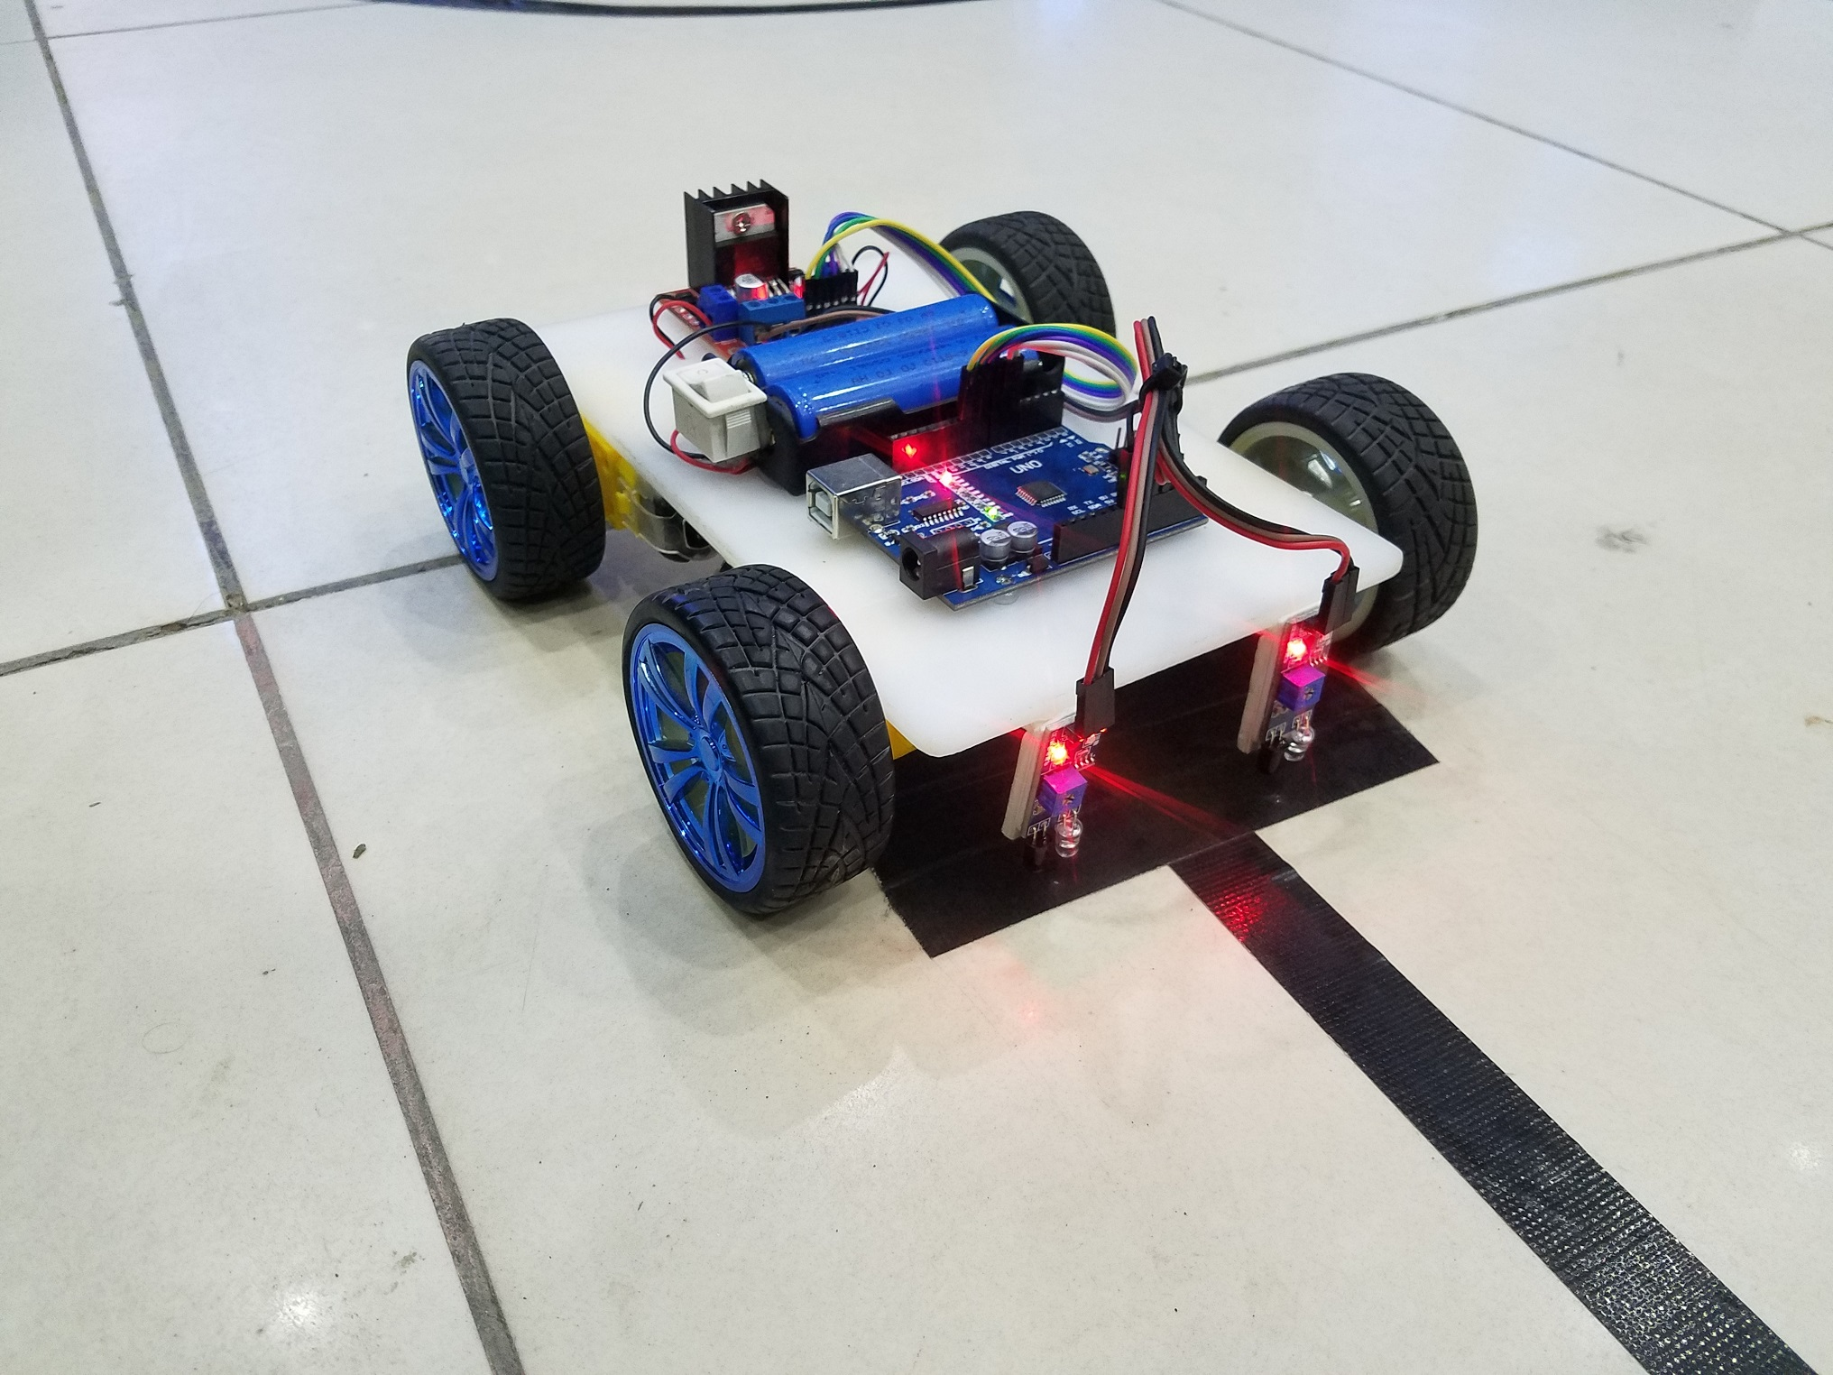

Slide 7
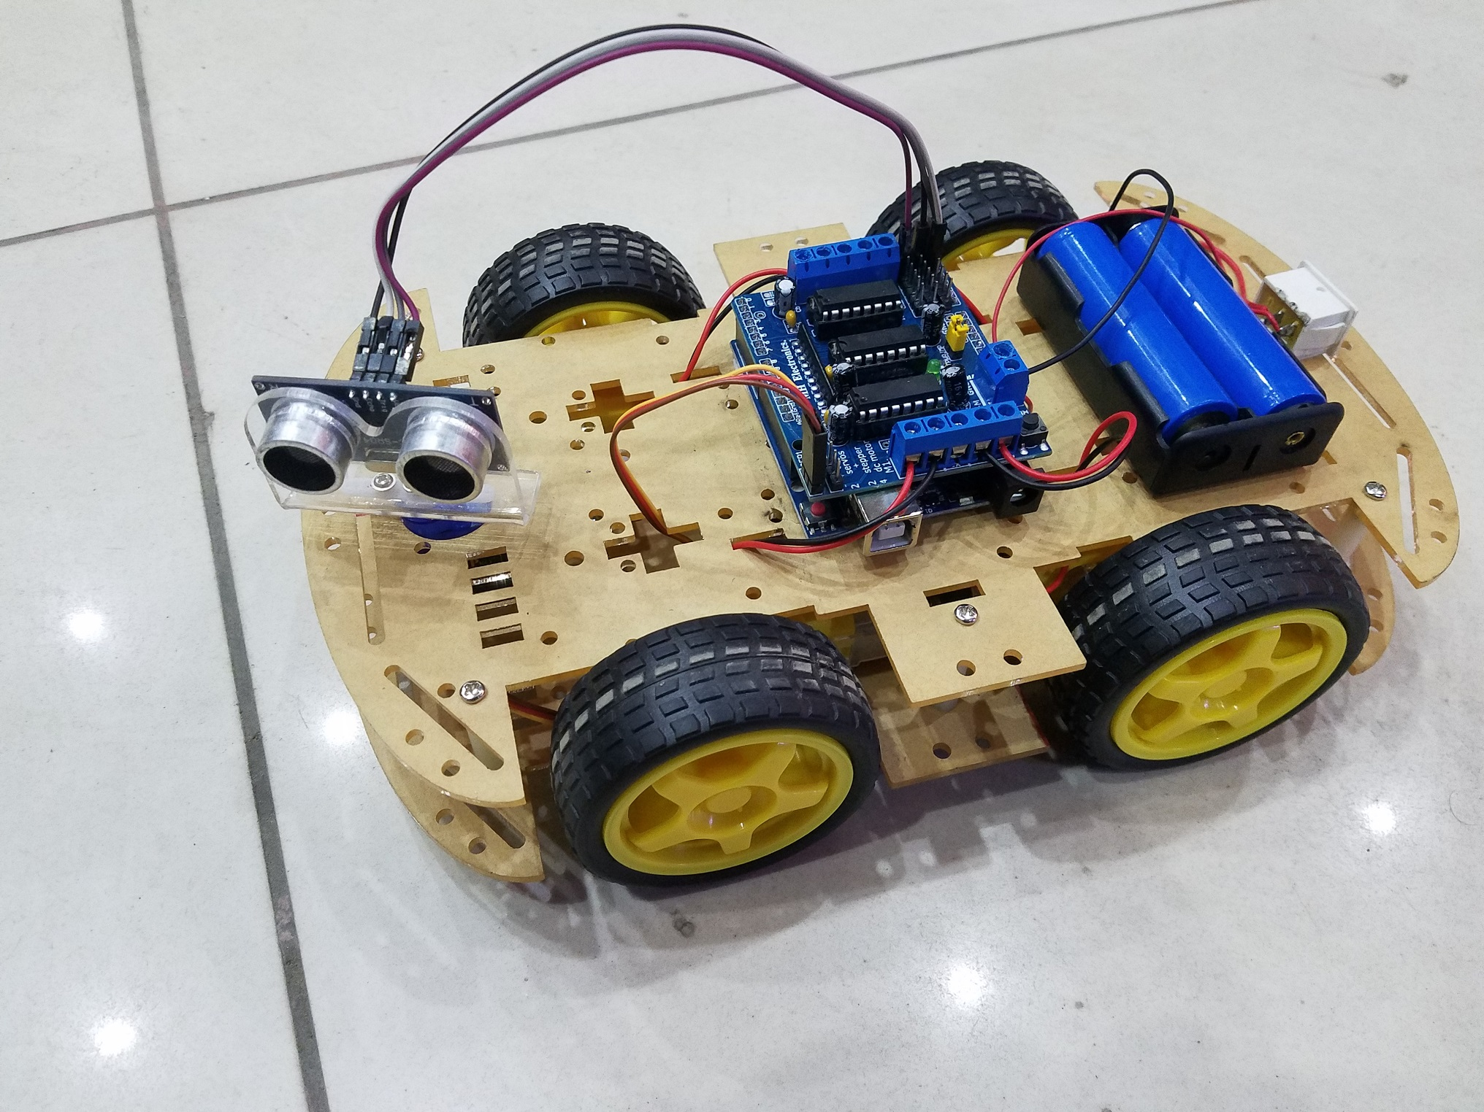
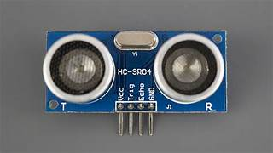
HC-SR04

Slide 8
ASSETS AND INVENTORY
With IoT, a warehouse can be aware of each moving part. Connected sensors track each asset across the premises. Smart shelves in warehouses can broadcast inventory information and warn warehouse managers of low stock, displaced products, unsuitable temperatures, theft, and so on.

Slide 9

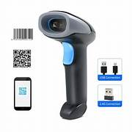

Slide 10
WEARABLES
Warehouse managers can now monitor each of their workers. Wearable devices can be distributed to all employees and used to track employee performance, health, and location inside the facility. Besides, the wearables can also report on collisions and falls thereby improving the safety of the operations.

Slide 11
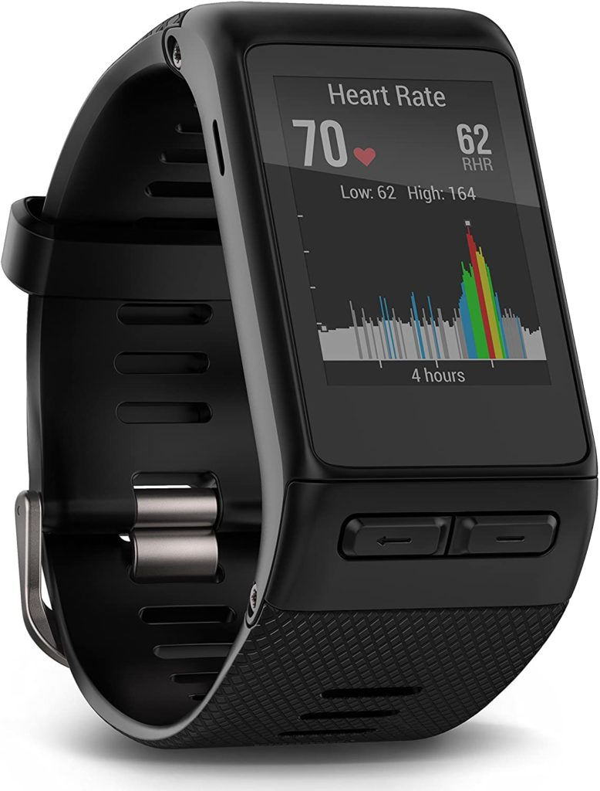


Slide 12
TRANSPORTATION
Telematic devices and GPS feed ensure that vehicles follow the recommended optimal route along with the constant update of ETA. Furthermore, IoT sensors tagged on the goods go beyond vehicle-level tracking by offering item-level visibility. This kind of granular information will allow operation managers to be more proactive than reactive in case of the condition of the goods breaching the threshold

Slide 13
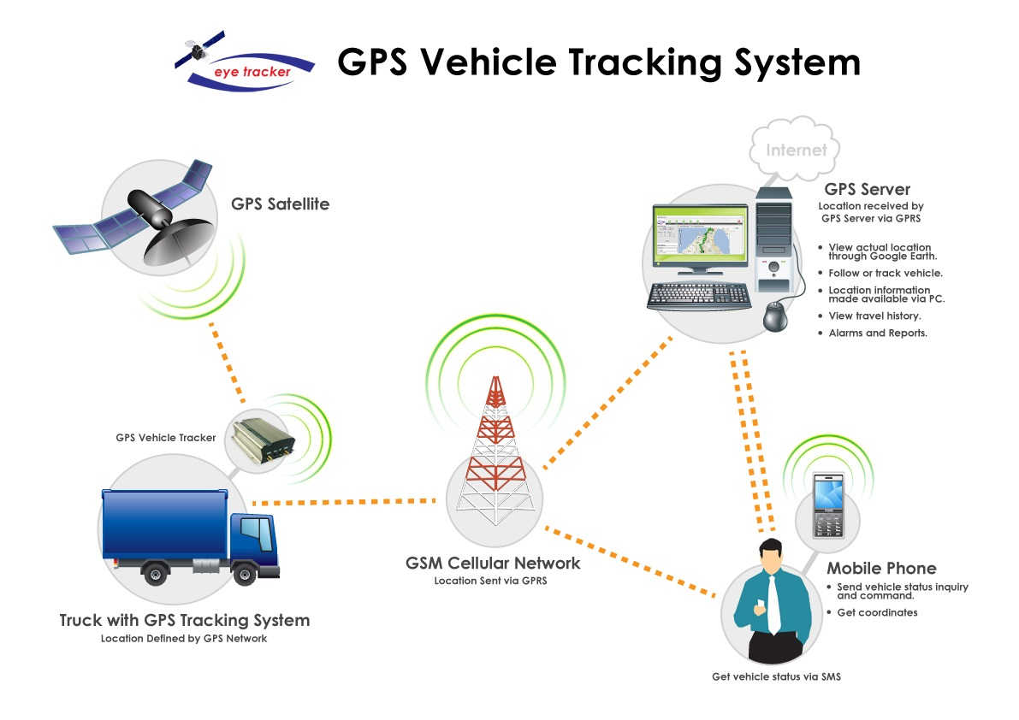

Slide 14
MAINTENANCE
IoT sensors can also help keep track of the operating conditions of equipment and machines. Combination of these operational equipment data with advanced machine learning algorithms can predict the failures of forklifts or other critical material handling equipment. IoT solutions in Warehouse management can empower the managers to keep productivity at maximum and the cost of repairs and downtime to a minimum.

Slide 15
The following factors have made Smart warehousing more imminent than ever before:
The decreasing cost of IoT sensors over the years. From about 40$ a piece in 2012 to less than 10$ in 2018 and possibly 2$ by 2020.
Increase in battery life with sensors lasting anywhere between 2 to 5 years making for a better ROI.
Extremely cheap computing and data processing power for IoT in warehouse
Prevalence of Low power wireless networks like LoRa, Sigfox, and NB-IoT allowing for cost-effective transmission of IoT-generated data.
Availability of a packaged, ready-to-deploy software that transforms sensor-generated data into actionable insights.

Slide 16
THANK YOU

